Slide 1

SAP BTP ABAP on Cloud / RAP Training
DAY-06
Anubhav Oberoy
www.AnubhavTrainings.com
Follow excellence with sheer passion

Slide 2


DISCLAIMER
The training content and delivery of this presentation is confidential, and cannot be recorded, or copied and distributed to any third party, without the written consent of Anubhav Trainings

Slide 3

01
Validations
02
Draft
03
Pre-checks & Augment
04
Authorization
Notes:
https://pixabay.com/photos/san-francisco-transamerica-pyramid-1633203/

Slide 4

Development Flow – Processor and Approver
Fiori App – Processor
Create, update, delete, copy travel
Fiori App – Approver
Display the travel request data
Service definition
Service Binding
Service definition
Service Binding
MDE for Processor Projection
MDE for approver Projection
BDEF Projection
For Processor
Expose what is needed by a processor role in company
Behavior Definition (BDEF)
Tell RAP framework regarding our operations which needs to be supported for BO (managed)
BDEF Projection
For Approver
Expose what is needed by a approver role in company
Business Object Projection
For Processor
30 fields to internet
Business Object (definition)
Includes the Travel, Booking and Booking Supplement CDS entities
100 fields
Business Object Projection
For Approver
25 fields
www.anubhavtrainings.com

Slide 5
Validations
Many times we would like to perform business specific checks in our application, The rap framework is only responsible to perform CURDQ operations. It does not know what are all the business rules applies to our code.
If we return FAILED and MESSAGE then the RAP will terminate the update/create and shows the message to the user on Fiori App.
www.anubhavtrainings.com

Slide 6
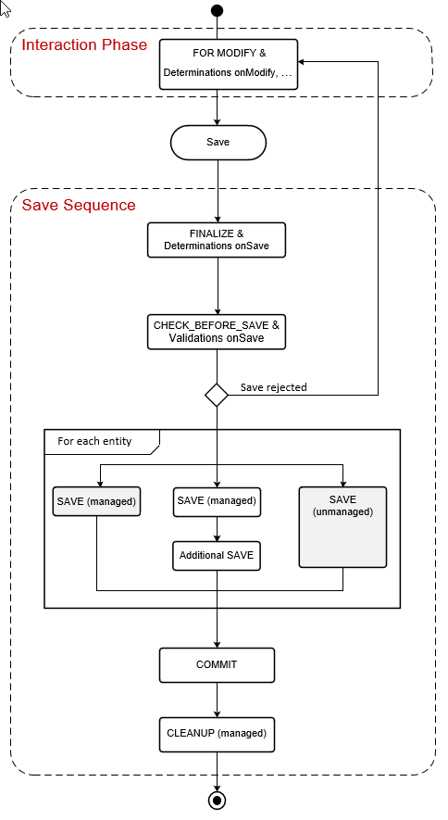
www.anubhavtrainings.com

Slide 7
Draft
Draft is a very important functionality of an enterprise application, which allows us
To create a stateful application from stateless
Store intermediate data in sap system
Perform validations on-fly, increases the collaboration with our app
Device switch
The Odata V4 never allow CURD operation without having draft feature to your BO
www.anubhavtrainings.com

Slide 8
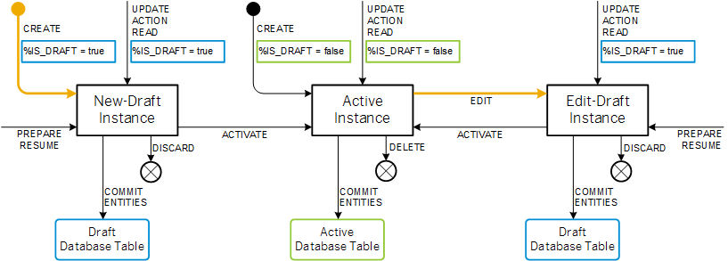
Draft Runtime
www.anubhavtrainings.com

Slide 9
Side Effects
Side effects are useful in UI scenarios based on BO which makes the Fiori element UI know/aware about the data changes in backend. Whenever data is reevaluated in backend, the frontend is unaware of that, we need to make sure that the frontend make a forceful call to GET the data back on UI.
The Fiori UI will never make an unnecessary call to perform a round trip. If we know that, a change in a field would certainly change the data in SAP system, we need to inform the same to RAP BO, so that it can make a GET call to reload the particular field value and display the updated data on UI. E.g. when we change the booking fee, or flight price under booking table, we need to reload the total price (which is getting calculated in backend using determination), this is exactly what the side effect can do for us.
www.anubhavtrainings.com

Slide 10
Prechecks
While the system is saving the draft in the draft table we can use prechecks to make sure that checks/authorizations are checked in the system before data reaches to draft table. Unlike validations (while saving/updating data to main table) Prechecks will trigger before data reaches to transaction buffer.
They are very helpful when we even want to validate data of one control based on another control. Currently as a developer you need to take additional pain to clean the data when draft is activated. If you apply precheck, system ensures that only the clean data reaches to transaction buffer.
Get The Country of Customer
Get The Country of Agency
www.anubhavtrainings.com

Slide 11
Augment
Before data reaches to transaction buffer, the augment code will be executed and here we can set some default data to the BO instance.
www.anubhavtrainings.com

Slide 12
Authorization
Authorization control in RAP protects our business object against the unauthorized access of data. Authorization control is always relevant when the permission to execute an operation depends on a role of BO consumer. In the RAP, each read or modify request can be checked via authorization object against the user role before the request is finally executed and reaches data.
The auth check with auth object is called from cds entities in case of read request – was covered in Anubhav trainings abap on hana course
And behavior implementation in case of modify request
Global authorization
Global authorization is used for all authorization checks that only depends on the user.
Global authorization checks can be implemented both for static and instance bound operations
Instance authorization
Instance authorization is used for all auth checks that, in addition to the user role, depend on the state of the entity instance in question (like exact record level). Its only possible for instance based operation
Operations that are executed from instance auth are CREATE and static actions
Use case: when a user tries to edit a travel request, if the travel request status is cancelled, then we need to check that if he/she is a manager or not. Only managers can edit a cancelled travel request. Since each travel request is different, we need to go with instance-based authorizations.
www.anubhavtrainings.com

Slide 13
www.anubhavtrainings.com
Thank You
End of Day 06
www.anubhavtrainings.com

Slide 14


We’re committed to empower you to be
#FutureReady
through powerful training solutions.
We build the workforce of the future.
250+
Corporate Clients
30,000+
Learners Trained
25000+
Learners Placed
FREE WEBINARS
Sign up for free webinars with industry experts every fortnight!
Enroll Now!
Contact us today!
https://anubhavtrainings.com

